Slide 1

Part II Computability Theory Chapter 3
CHURCH TURING THESIS

Slide 2
Agenda
Description of Turing Machines
Element Distinctness Problem
Variants of Turing Machines
TM which can “stay put”
Multi-tape TM
Non deterministic TM
Turing Machines for Function Computation
Turing Machine as Enumerators
Universal TM
The Church-Turing Thesis
Hilbert's Tenth Problem

Slide 3
Description of TM
Let C = {a^{i}b^{j} c^{k} | i × j = k and i, j, k ≥ 1}.
A decider (TM) M for C :
1. Scan the input to be sure that it is a member of aa∗bb∗cc∗ and reject if it isn’t.
2. Return the head to the left-hand end of the tape.
3. Cross oﬀ an a and scan to the right until a b occurs. Shuttle between the b’s and c’s, crossing oﬀ one of each until all b’s are gone.
4. Restore the crossed oﬀ b’s and repeat Stage 3 if there is another a to cross oﬀ.
5. If all a’s and c’s are crossed oﬀ, accept ; otherwise, reject.

Slide 4
Simulating Tape
B | B | B | a | a | b | b | b | c | c | c | c | c | c | B | B | B | B | B | B
B | B | B | a | a | b | b | b | c | c | c | c | c | c | B | B | B | B | B | B
B | B | B | X | a | b | b | b | c | c | c | c | c | c | B | B | B | B | B | B
B | B | B | X | a | Y | Y | Y | Z | Z | Z | c | c | c | B | B | B | B | B | B
B | B | B | X | a | b | b | b | Z | Z | Z | c | c | c | B | B | B | B | B | B
B | B | B | X | X | b | b | b | Z | Z | Z | c | c | c | B | B | B | B | B | B
B | B | B | X | X | b | b | b | Z | Z | Z | Z | Z | Z | B | B | B | B | B | B

Slide 5
Element Distinctness Problem
It is given a list of strings over {0,1} separated by #s and its job is to accept if all the strings are different. The language is:
E = {#x₁#x₂# · · · #x_{l} | x_{i} ∈ {0, 1}∗ and x_{i} <> x_{j} (for i <> j)}.
All languages are Decidable so they are all Turing Recognizable

Slide 6
High-level description of TM
1. Place a mark on top of the leftmost tape symbol. If that symbol was not a #, reject.
2. Scan right to the next # and place a second mark on top of it. If no # occurs before a blank, accept.
3. Compare, by zig-zagging, the two strings to the right of the marked #’s. If they are equal, reject.
4. Move the second mark to the next # symbol. If not doable, move the ﬁrst mark to the next # to its right and the second mark to the # after that. If not doable, accept.
5. Go to Stage 3

Slide 7
Variants of Turing Machine
Alternative deﬁnitions of Turing machines abound, including versions with multiple tapes or with non-determinism. They are called variants of the Turing machine model.
The original model and its reasonable variants all have the same power—they recognize the same class of languages.
To show that two models are equivalent, we simply need to show that we can simulate one by the other.

Slide 8
Multitape TM
A multitape Turing machine is like an ordinary Turing machine with several tapes.
Each tape has its own head for reading and writing.
Initially the input appears on tape 1 and the others start out blank.
The transition function is changed to allow for reading, writing, and moving the heads on all the tapes simultaneously. Formally,
δ : Q × Γ^{k} −→ Q × Γ^{k} × {L, R}^{k},
where k is the number of tapes.

Slide 9
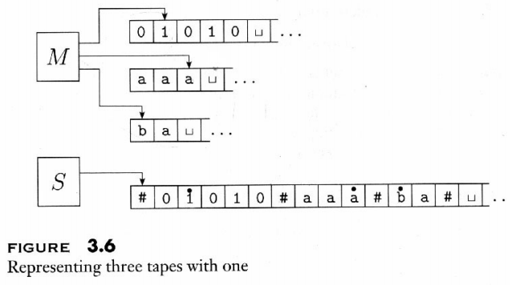
Diagram

Slide 10

Simulating Multitape TM
Every multitape Turing machine has an equivalent single tape Turing machine
A single tape TM S can simulate a k-tape M :
1. S puts its tape into the format that represent all k tapes of M:
2. To simulate a single move of M , S scans its tape to determine the symbols under the virtual heads. Then S makes a second pass to update the tapes according to M ’s transition function.

Slide 11
3. If at any point S moves one of the virtual heads to the right onto a #, this action signifies that M has moved the corresponding head onto the previously unread blank portion of that tape. So S writes a blank symbol on this tape cell and shifts the tape contents, from this cell until the rightmost #, one unit to the right. Then it continues the simulation as before.”

Slide 12
Non deterministic Turing Machine
A nondeterministic Turing machine is deﬁned in the expected way.
The transition function of a nondeterministic TM has the form
δ : Q × Γ −→ P (Q × Γ × {L, R}).
The computation of a nondeterministic TM is a tree whose
branches correspond to diﬀerent possibilities for the machine.
If some branch of the computation leads to the accept state, the
machine accepts its input

Slide 13
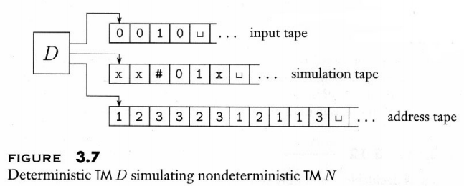
Simulating NDTM
Every Nondeterministic Turing machine has an equivalent Deterministic Turing machine
The idea is to have a deterministic TM D try all possible branches of the given nondeterministic TM N ’s computation.
D searches, in a breadth ﬁrst manner, N ’s computation tree for an accepting conﬁguration.

Slide 14
Simulating NDTM
D has three tapes:
Tape 1 always contains the input string and is never altered.
Tape 2 maintains a copy of N ’s tape on some branch of its nondeterministic computation.
Tape 3 keeps track of D’s location in N ’s nondeterministic computation tree.

Slide 15
Simulating NDTM
Adding non determinism to Turing machines does not allow them to recognise any more
languages.
A nondeterministic Turing machine that halts on every branch of its computation on all inputs is
called a decider.
A language is decidable iﬀ some NDTM decides it.

Slide 16
Turing Machines for Computing Functions
Kindly check the link turingmachine.io on Yammer for better understanding
Unary representation is used in order to do any arithmetic operations on a TM.
Unary representation looks as follows
0 → 1
1 → 11
2 → 111
3 → 1111
4 → 11111

Slide 17
Example: Adding two non-zero numbers
Input Tape . . b 1 1 1 b 1 1 b . .
Output should be: . . b b b 1 1 1 1 b . .
(1,1,b,R,2): Erase leftmost 1 and move right
(2,1,b,R,3): Erase second 1 and move right
(3,1,1,R,3): pass over any 1’s until a blank is found
(3,b,1,R,4): write 1 over the blank
(4,1,1,R,4): pass over remaining 1’s
(4,b,b,R,5): halt
S1... b 1 1 1 b 1 1 b...
S2... b b 1 1 b 1 1 b...
S3... b b b 1 b 1 1 b...
S3... b b b 1 b 1 1 b...
S4... b b b 1 1 1 1 b...
S4... b b b 1 1 1 1 b...
S4... b b b 1 1 1 1 b...
1;1,R
1;1,R
Halt
1;b,R
1;b,R
b;1,R
b;b,R
1
2
3
4
5

Slide 18
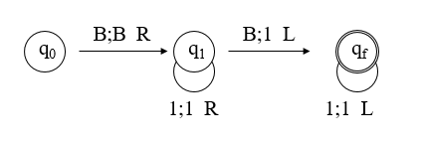
Some More Examples
Successor Function
Zero Function
Predecessor Function
s : N → N has s(n) = n+1 for all inputs n:
z : N → N has z(n) = 0 for all inputs n:
pred : N → N has pred(n) = n-1 if n>0 and has pred(0) = 0:

